Slide 1


Overview of Top Performing Content Categories

Slide 2


Today's agenda
Project recap
Problem
The Analytics team
Process
Insights
Summary

Slide 3

Brief overview of the project
Goals and objectives
Key points from the project brief
Merge three tables (Content, Reaction, ReactionTypes)
Calculate total scores for each category
Identify top 5 performing categories
Project Recap

Slide 4


Problem
We are addressing the challenge of identifying the top-performing content categories on Social Buzz. With vast amounts of user-generated content and diverse reactions, it is crucial to determine which categories are driving the most engagement and positive feedback.

Slide 5



Andrew Fleming: Chief Technical Architect
Marcus Rompton: Senior Principal
Nikita Suresh : Data Analyst (or your role)
The Analytics team

Slide 6
Process
1
Upload and inspect the data
2
Merge the three tables
Clean and prepare the data
3
Calculate total scores for each category & Identify top 5 performing categories
4
5
Analyze and visualize the results

Slide 7
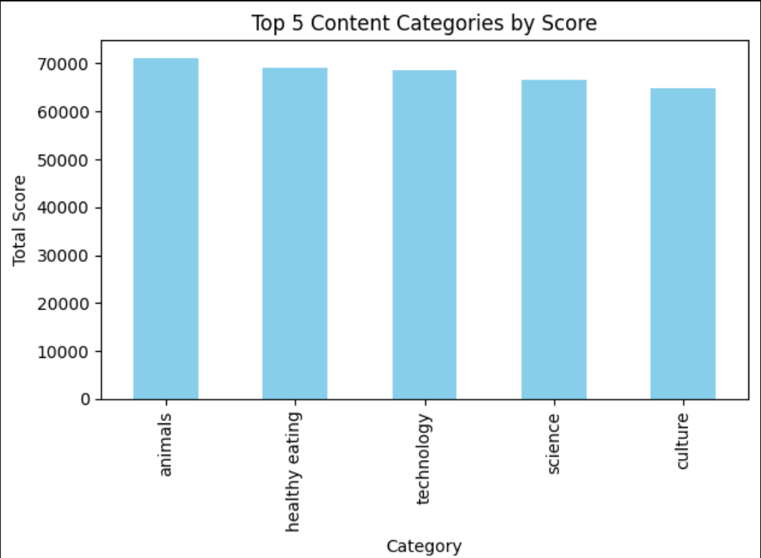
Insights

Slide 8
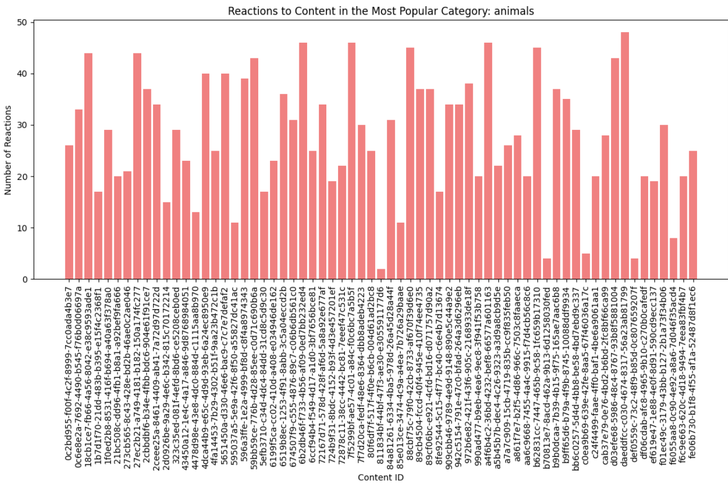

Slide 9
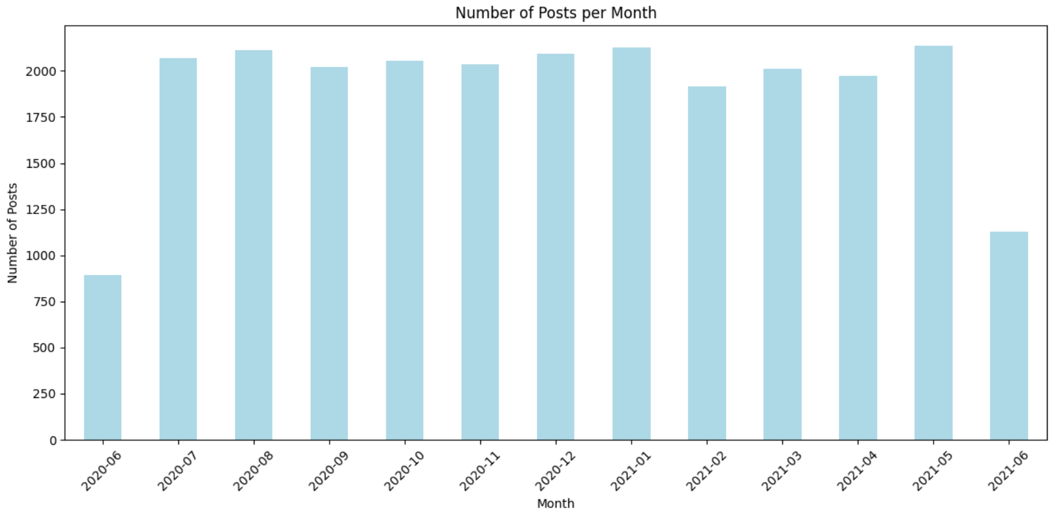

Slide 10
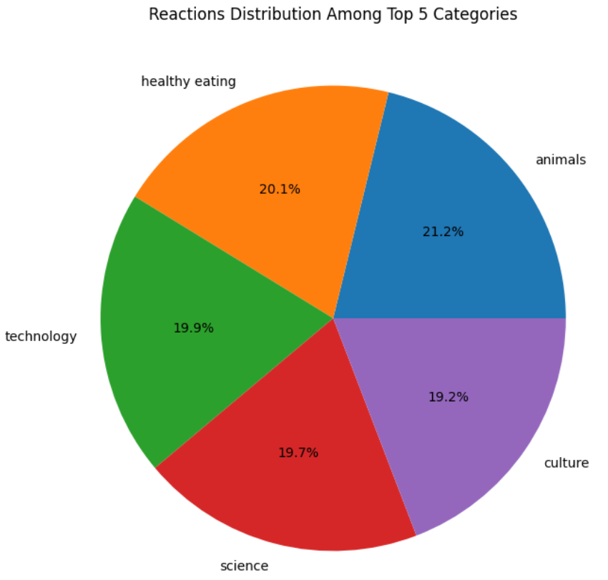

Slide 11
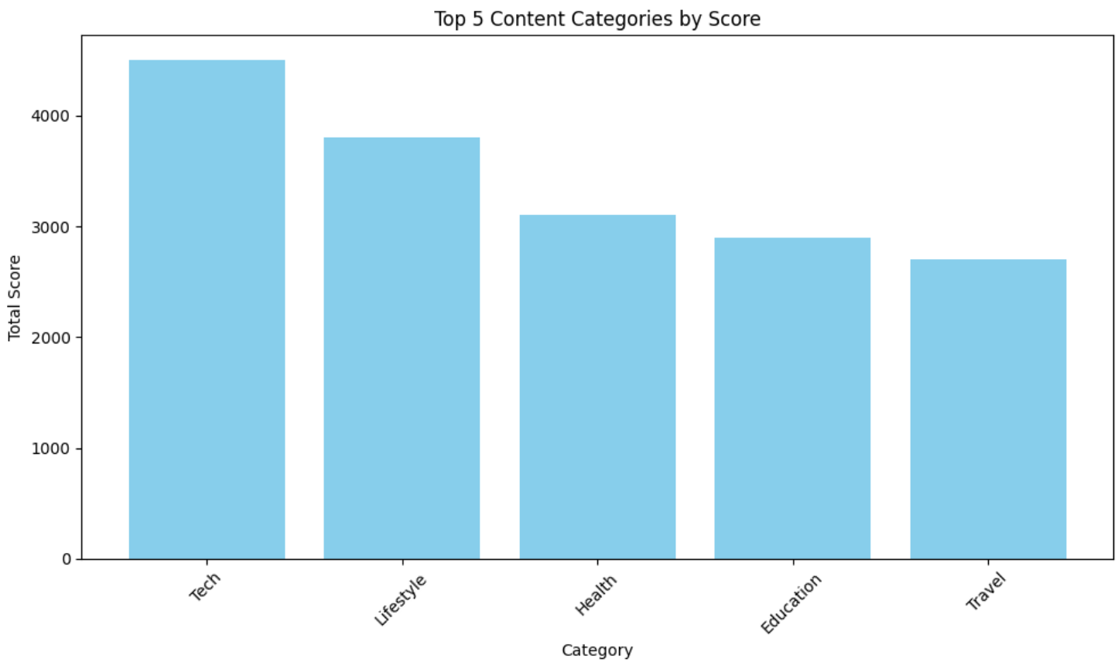

Slide 12
Summary
How many unique categories are there?
Number of Unique Categories: 29
How many reactions are there to the most popular category?
Reactions to the Most Popular Category: 1805
What was the month with the most posts?
May 2021

Slide 13

Thank you!
ANY QUESTIONS?

